Slide 1
Estimating and Visualizing Population Genetic Structure for Landscape Genomics

Slide 2
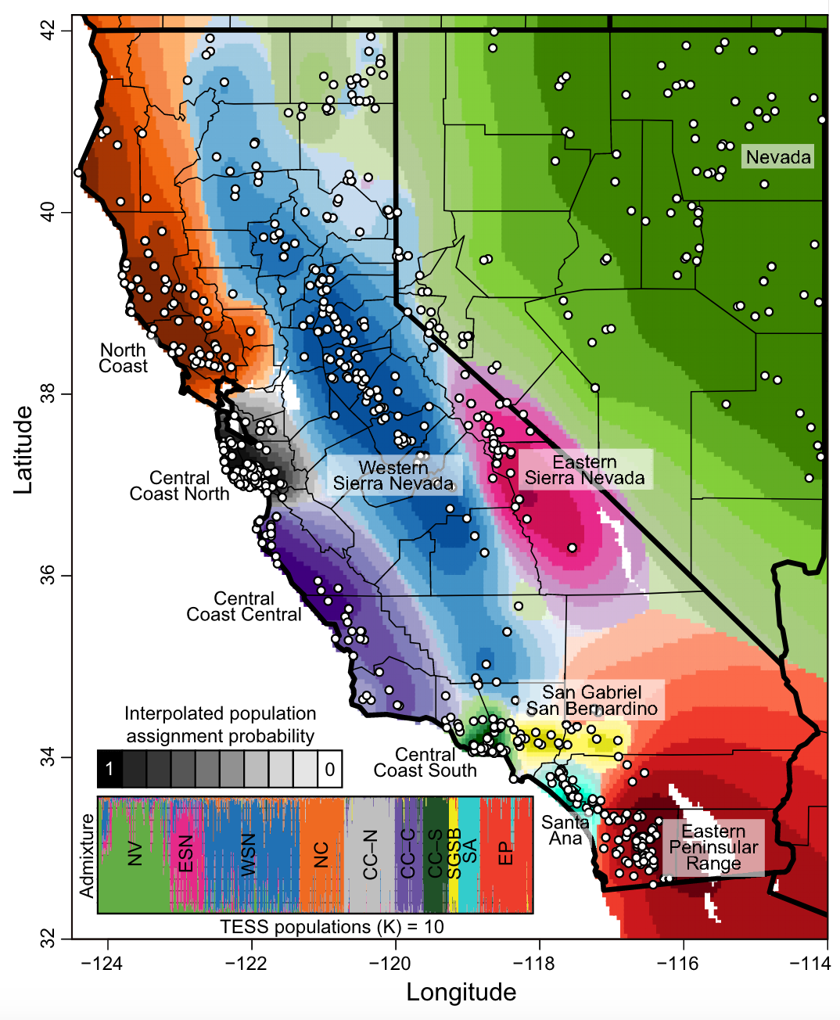
What is Landscape Genomics?
Study of the the interaction between landscapes and genetic variation
Manel et al. 2003
Introduces the concept of landscape genetics, bridging landscape ecology and population genetics
Reviewed and described research methodologies for studying the interaction between landscapes and genetic variation
Manel et al. 2013
Landscape genomics emerging from landscape genetics as technology improved

Slide 3
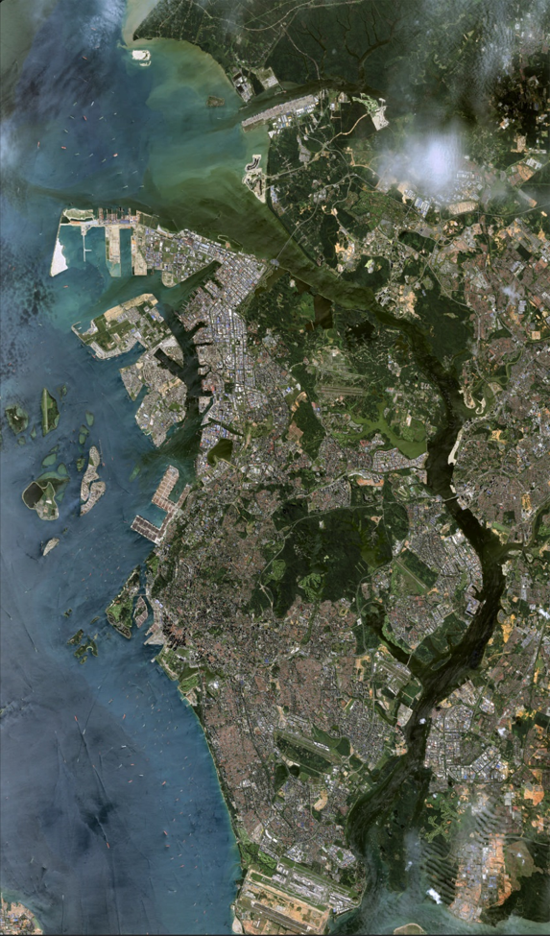
Why Include Spatial Data?
Genetic data isn't isolated
It's intricately woven into the fabric of geography
Populations are extensions of their environment
The environmental characteristics of a landscape are strong drivers of genetic variation and evolutionary processes
To better understand a species’ evolutionary history and trajectory, we must consider the spatial dimensions of genetic information

Slide 4
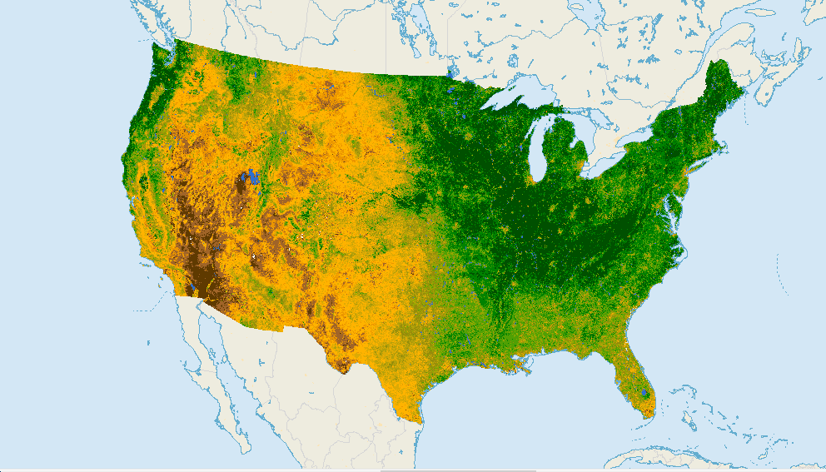


Types of Data
Geographic
Data
Genomic
Data
Environmental
Data

Slide 5
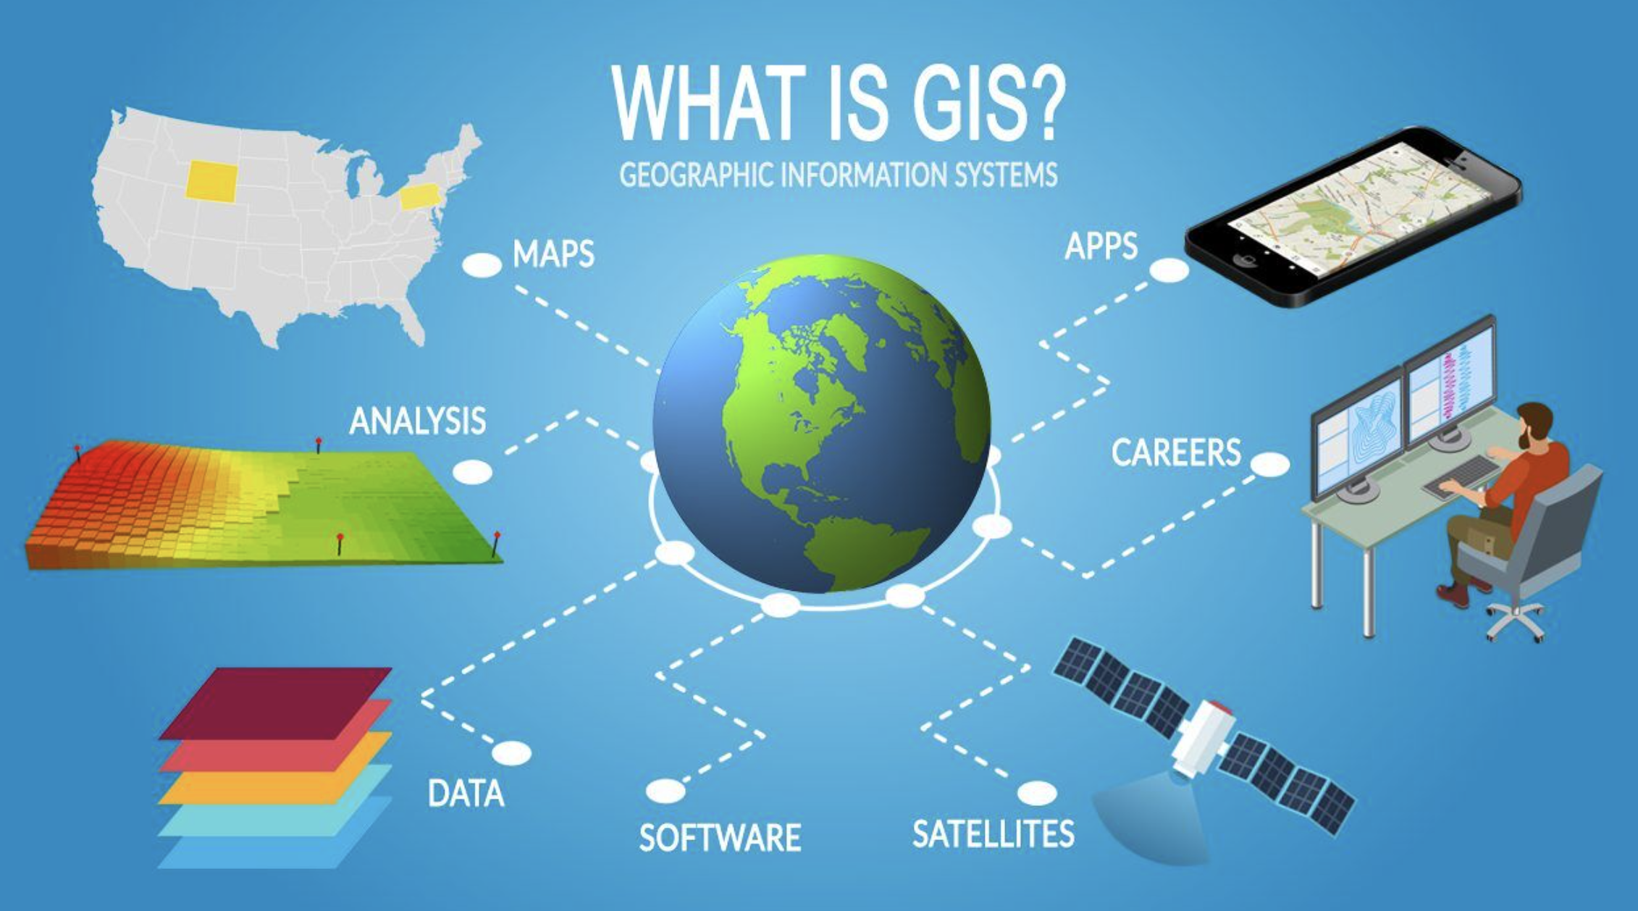

Geographic Data
Geographic Information Systems (GIS)
Framework for gathering, managing, and analyzing spatial or geographic data
Analyzes spatial relationships to uncover patterns and trends
Can be leveraged to analyze genomic data
Examples of useful geospatial data:
Telemetry/tracking Data
Camera Traps

Slide 6
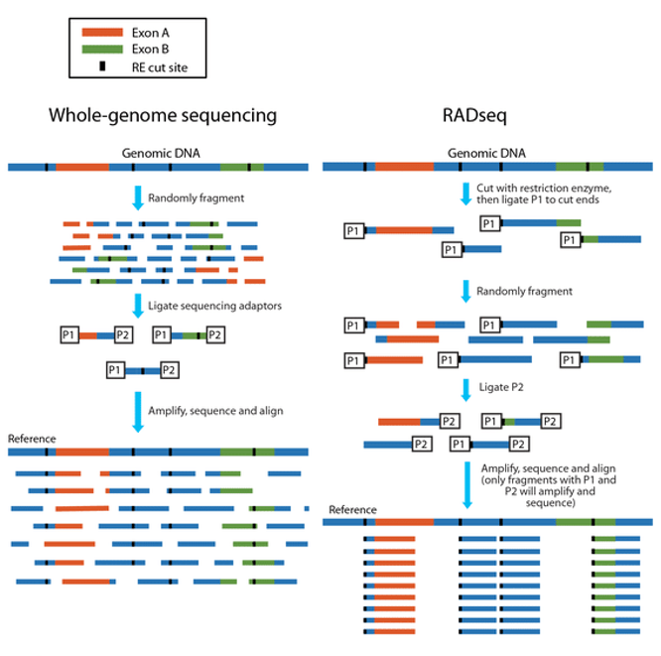
Genomic Data
Examples:
Whole Genome Sequencing (WGS)
Restriction site-associated DNA sequencing (RADseq)
Microsatellite Markers

Slide 7
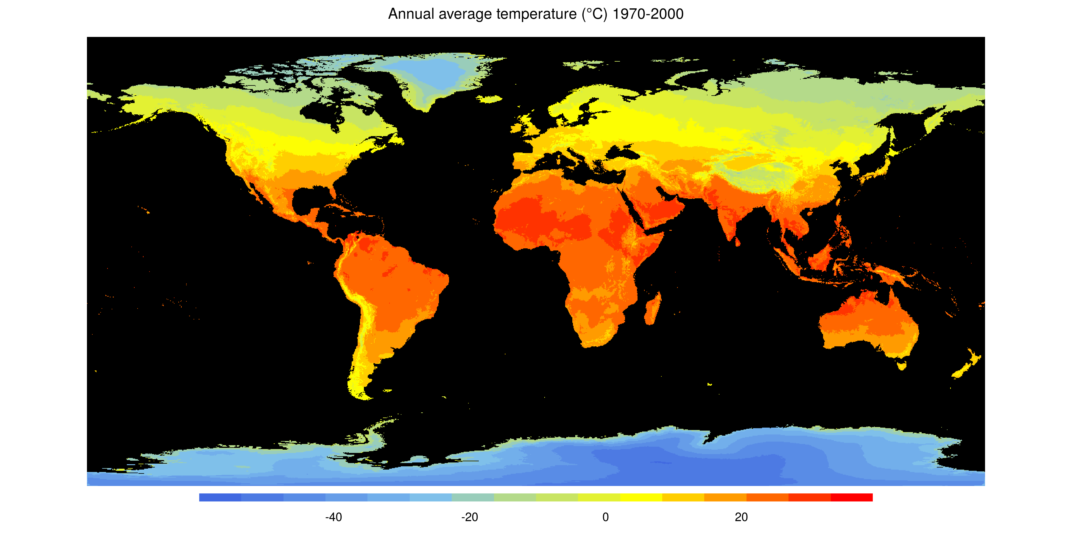
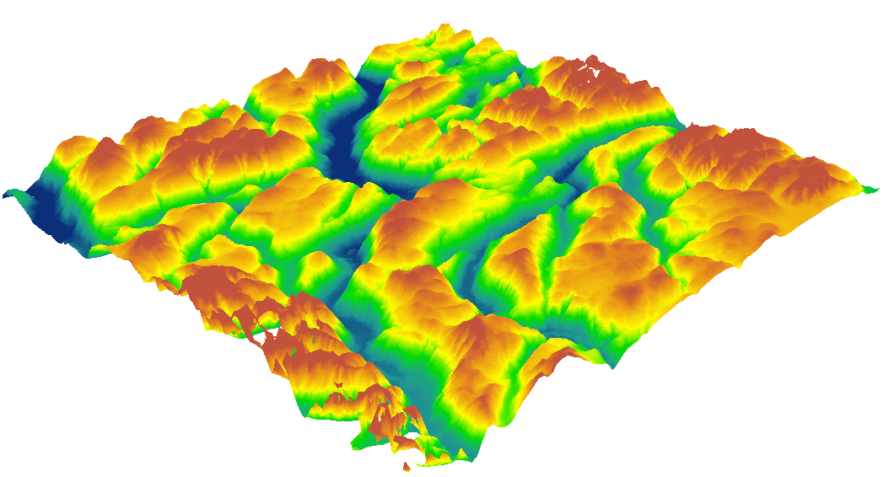
Environmental Data
Global Environmental Datasets:
Source: Government agencies or research institutions
Can include climate, land use, and ecological variables
Examples:
WorldClim database
NASA Landsat data
Regional GIS Databases
Leverage geographic information systems (GIS) databases that compile various environmental layers, including soil types, topography, and hydrology
Availability often depends on region

Slide 8
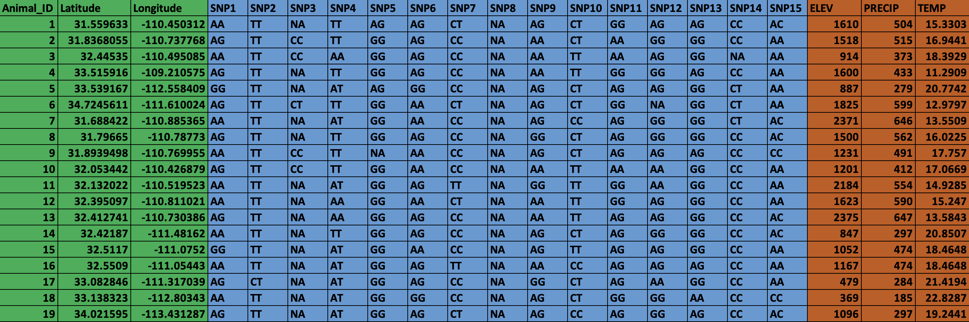
Data Matrix
Geographic
Data
Genomic
Data
Environmental
Data

Slide 9
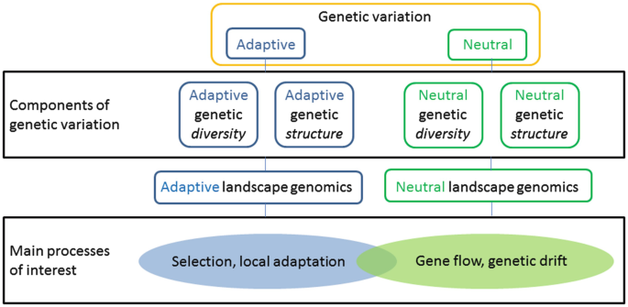
How Can We Use This Data to Understand Evolutionary Processes?
Assess adaptive evolution
Identifies genetic variations influenced by local environmental factors
Example: Gene-Environment Associations (GEA)
Assess non-adaptive (neutral) evolution
Analysis of spatial genetic structure
Evaluate relationships between individuals to estimate relatedness based on genetic data

Slide 10
How Can We Use This Data to Understand Evolutionary Processes?
Assess adaptive evolution
Identifies genetic variations influenced by local environmental factors
Example: Gene-Environment Associations (GEA)
Assess non-adaptive (neutral) evolution
Analysis of spatial genetic structure
Evaluate relationships between individuals to estimate relatedness based on genetic data

Slide 11
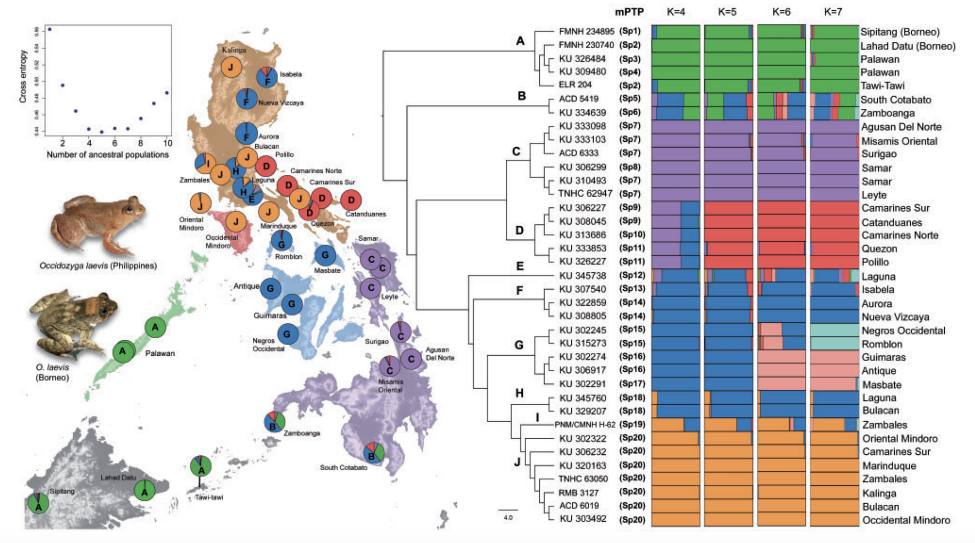
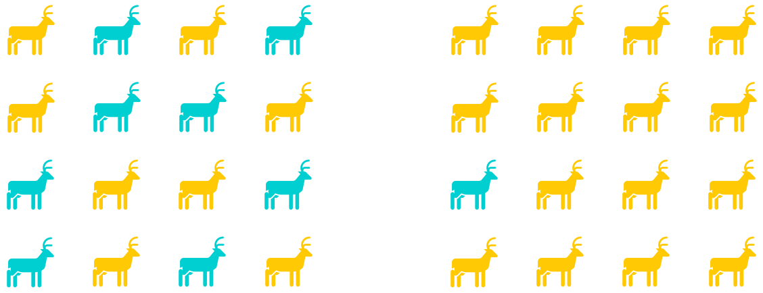

Analyzing Spatial Genetic Structure
Genetic Structure
Often measured in terms of ancestry coefficients
The proportion of individual’s genomes that originate from multiple ancestral gene pools
Genetic structure can mimic selection, despite being driven by non-selective factors
Quantifying genetic structure helps incorporate its effects into subsequent analyses focused on adaptations within population
Chan et al. 2022

Slide 12
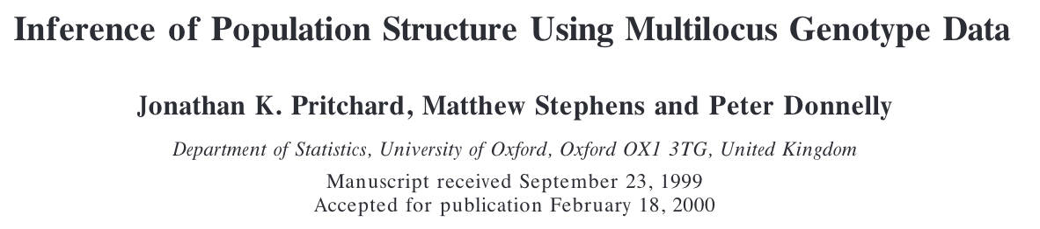
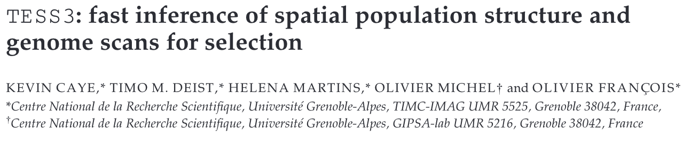
Analyzing Spatial Genetic Structure
STRUCTURE (Pritchard et al. 2000)
Uses matrix models and Bayesian statistics to estimate ancestry coefficients
Stochastic algorithms (like MCMC in STRUCTURE) can be computationally demanding when using large numbers of individuals or loci
TESS3 (Chen et al. 2007)
Model-free and spatially explicit
Accounts for geographic distance among individuals to interpolate ancestry coefficients on a landscape

Slide 13
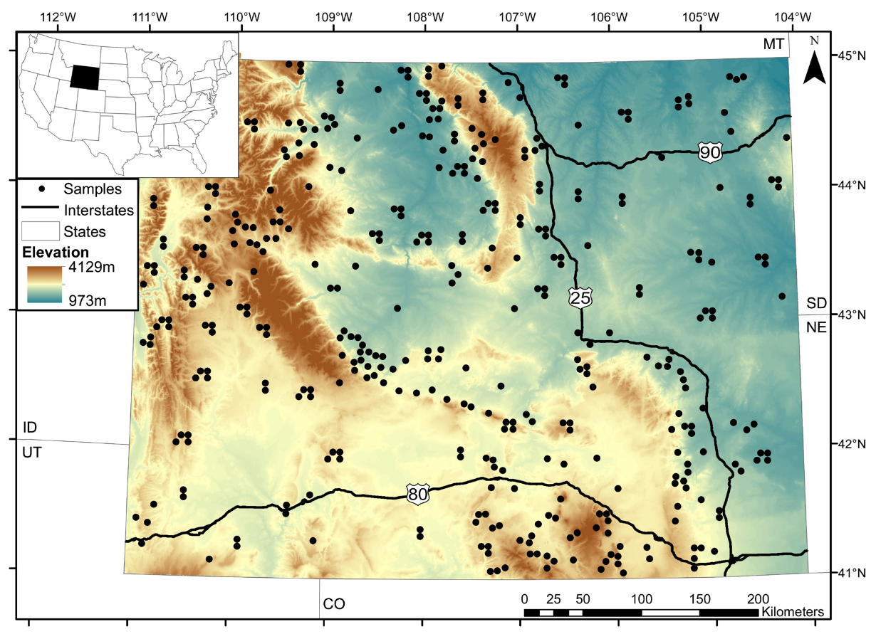
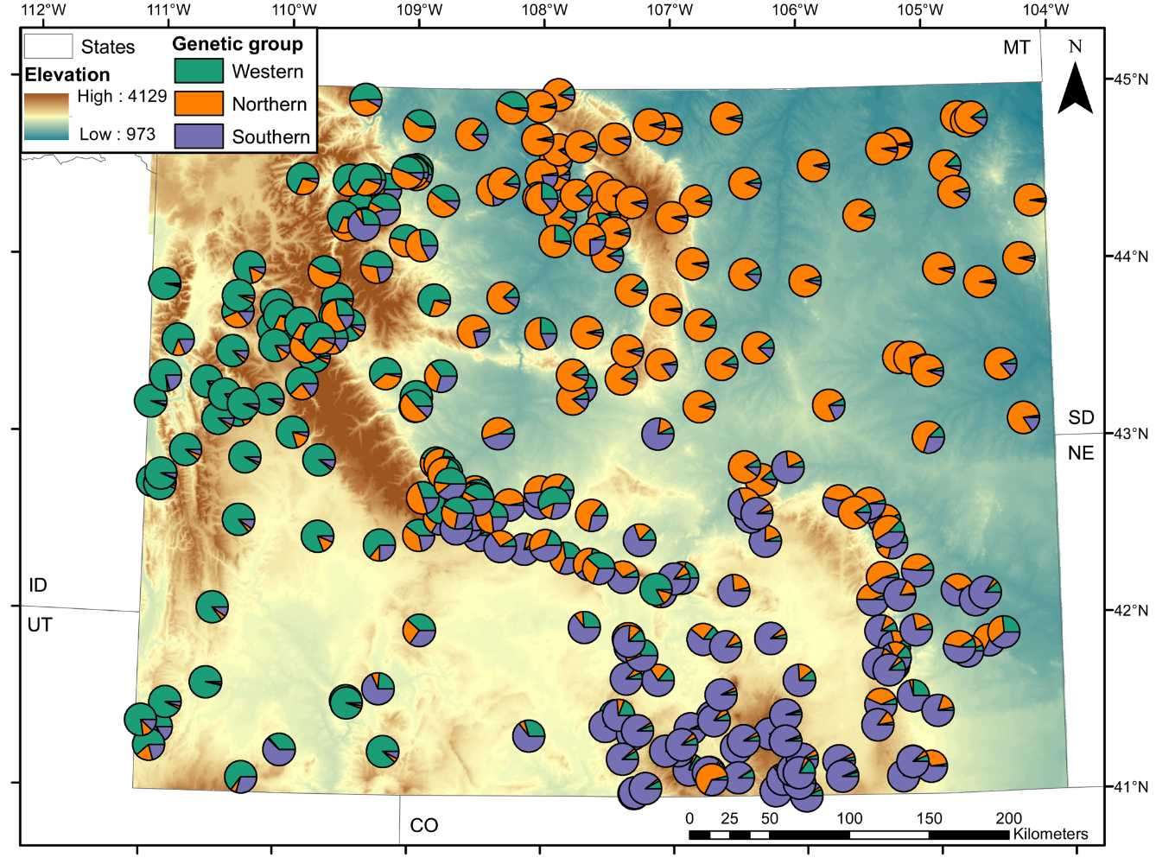
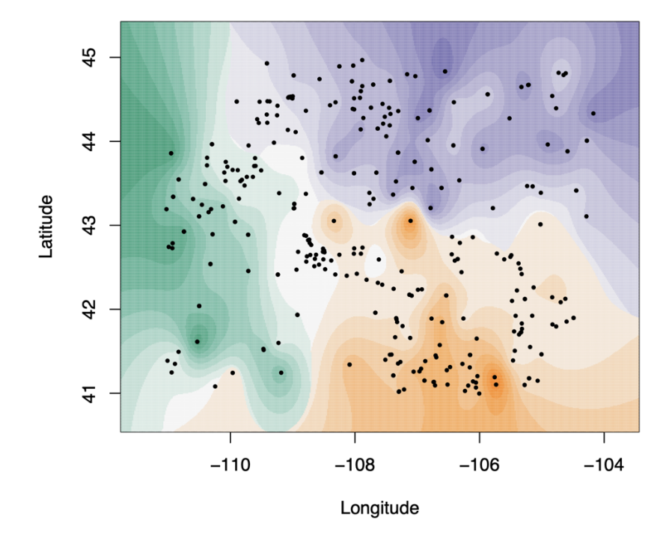
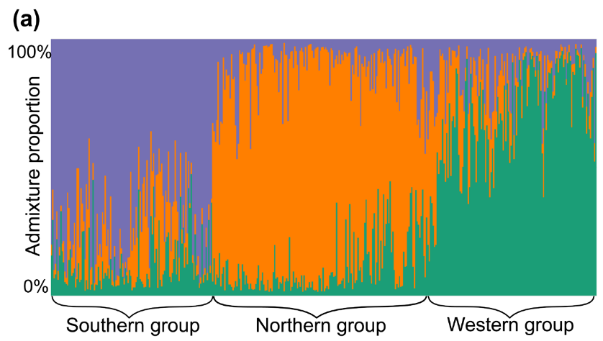
Analyzing Spatial Genetic Structure
Occurrence Data
STRUCTURE
TESS3

Slide 14
TESS3 Demo

Slide 15





TESS3: Estimating Ancestry Coefficients
TESS3 is available as R package `tess3r`
TESS3 estimates ancestry coefficients ($Q$) using a least-squares minimization algorithm
Generated when least squares are minimized between $X$ and $QG$
$$P\left(X_{il}=j\right)=\sum_{k=1}^{K}{Q_{ik}G_{kl}(j)}$$
Probability that individual $i$ carries the genotype$j$ at locus $l$(e.g. AA)
Based on observed data
Individual ancestry coefficients
Fraction of an individual’s genome that originates from ancestral population $k$
Ancestral genotypic frequencies
Frequency of genotype $j$ at locus $l$ in population $k$
Caye et al 2016

Slide 16
TESS3: Input Data
We will be using the built-in example data for Arabidopsis thaliana (`data.at`)
TESS3 primarily uses the following types of input data:
Genomic data
Genotype matrix
Geographic data
Longitude and latitude
What is the spatial extent (scale) of this data?
What do rows and columns represent?
How many SNPs are we analyzing?

Slide 17
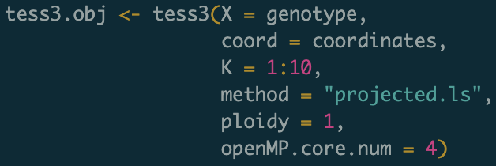
TESS3: Function and Arguments
Will take 1-15 minutes to run on most laptops
`X`: Genotype matrix
`coord`: Coordinate data
`K`: Number of possible ancestral populations we’d like to compare
`method`: Least squares algorithm used (default as described is “projected.ls”)
`ploidy`: Ploidy of organism

Slide 18
TESS3: Choosing Optimal Number of K
K is determined using cross-entropy cross-validation criterion (Frichot et al. 2014)
Partitions genotypic matrix into training and test sets
Compares predicted genotypic frequencies between observed sets at each locus
Smaller values imply better estimates in TESS3
Cross-validation score
Number of ancestral populations
Somewhat subjective: Optimal K choice observed at plateau in cross-entropy plot
Defines major clusters, but not necessarily all hierarchical structuring

Slide 19
TESS3: Plotting Ancestry Coefficients
STRUCTURE, ADMIXTURE, and similar approaches often represent ancestry coefficients with box plots, where colors represent ancestral populations and columns represent individuals
If geographic data is available, box plots may be converted to pie charts layered on a map
TESS3 output can similarly be represented this way

Slide 20
TESS3: Plotting Ancestry Coefficients
`plot` can interpolate Q-matrix values generated by TESS3 on a geographic map

Slide 21
What to do next?
Often good practice to compare results with STRUCTURE/ADMIXTURE and other methods
Can also be useful when determine the environmental factors most strongly influencing population structuring

Slide 22
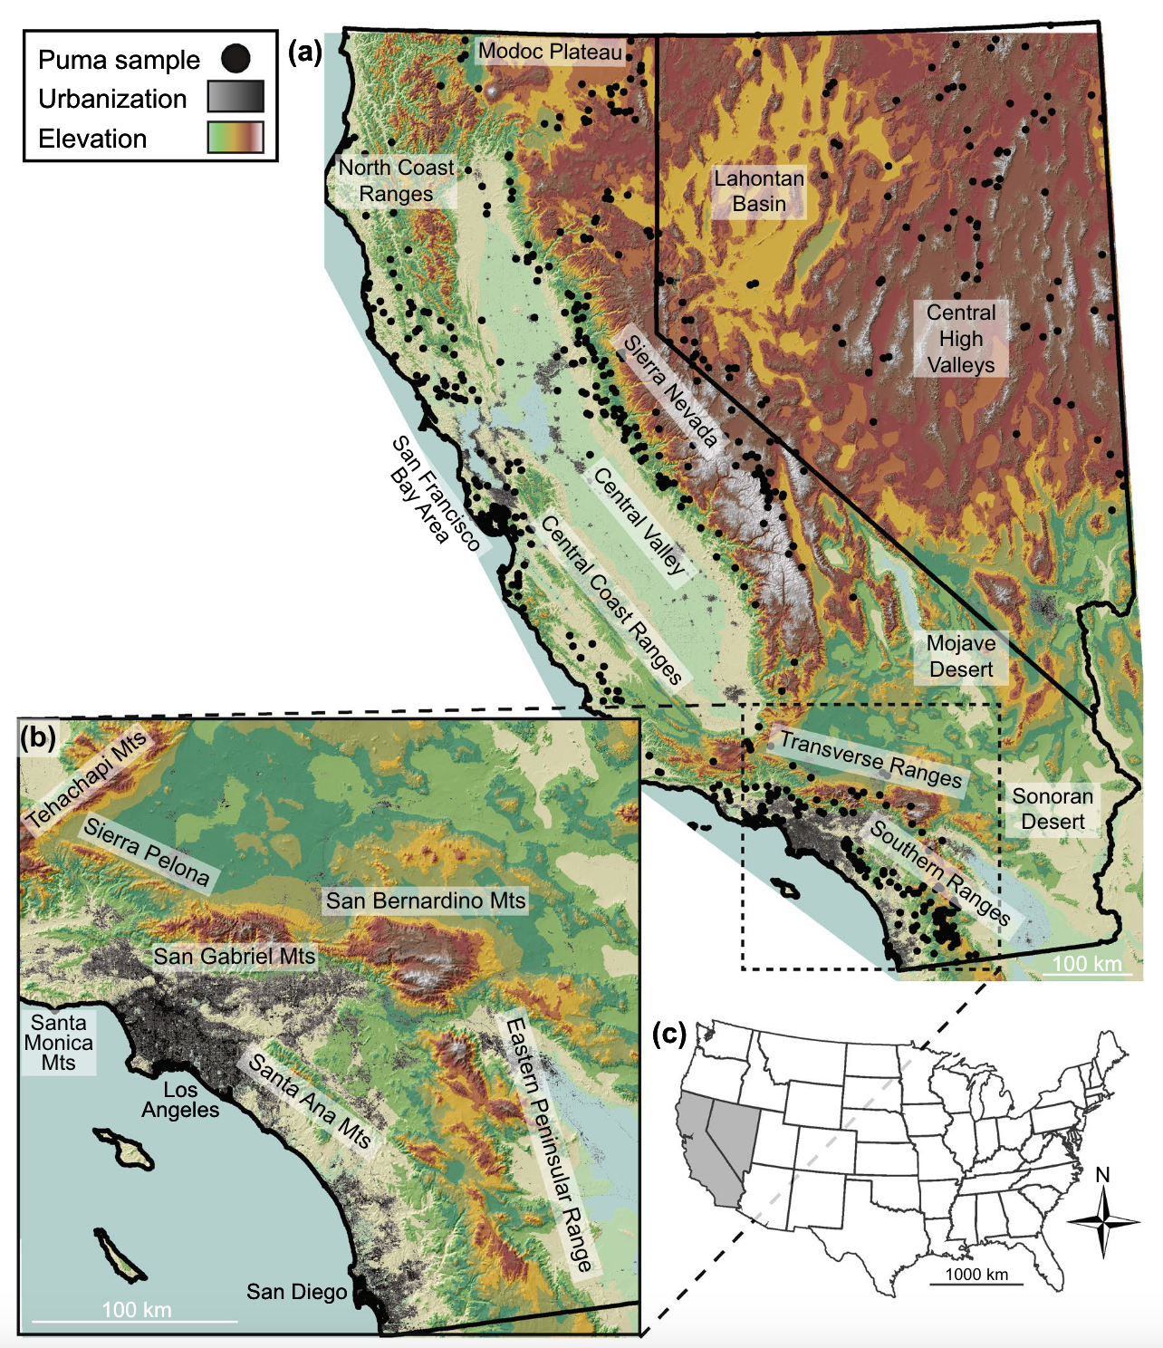
What to do next?
Example: Gustafson et al. 2018
Genetic data from Puma concolor in California and Nevada
Evaluated population structure using TESS
Identified 10 populations
Genetic structure was likely influenced by urbanization
Lower genetic diversity along western coast
In some populations, genetic diversity was as low as what is seen for FL panthers

Slide 23
TESS3: Identifying Outlier Loci
Ancestry coefficients can also be useful when assessing adaptive evolution
TESS3 can use ancestry coefficients to generate Fst values
Can then generate p-values to identify outliers
Benjamini-Hochberg algorithm used to control for false-discovery rate

Slide 24
Takeaways
Assessing population structure is useful for understand how neutral evolutionary processes may have influenced genetic variation
Can be useful for generating hypotheses and identifying patterns
Important to account for when assessing adaptive evolutionary processes
TESS3 is a fast method for estimating ancestry coefficients when using thousands of loci and/or individuals
However, it’s usually good to compare results with other methods

